Slide 1

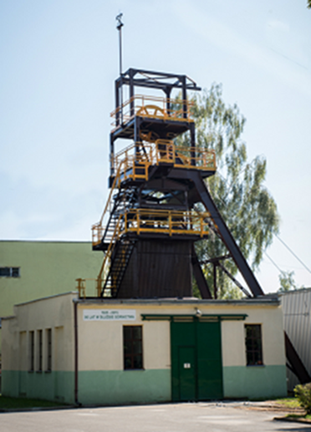
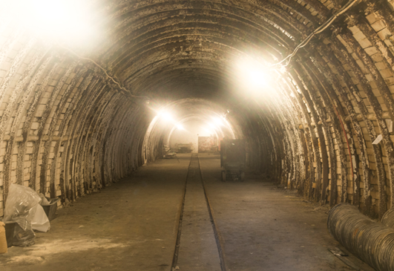
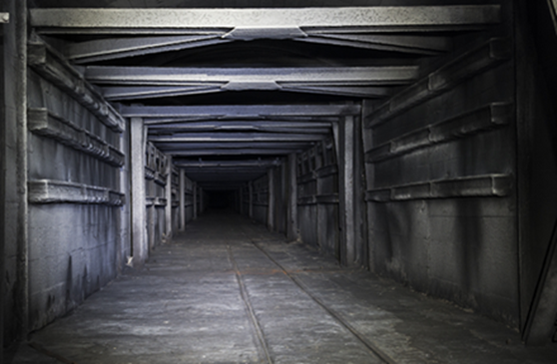
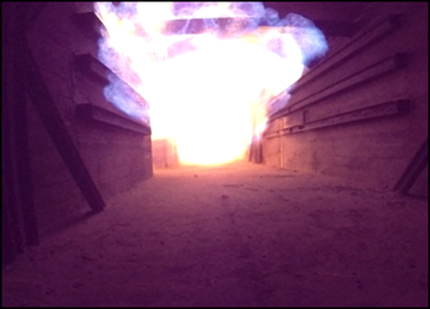
Experimental Mine ‘BARBARA’
in Mikołów (Poland)
VAM - MRV related activities
and possibilities

Slide 2
Possible VAM tests to be performed- areas of cooperation
Assesment of so far VAM emissions measurements accuracy
with the use of:
drones
planes
satellites
Verification of VAM emissions’ measurements in mine ventilation shafts (exhaust) - by installing extra methane sensors in additional locations of the exhaust shaft cross-section

Slide 3

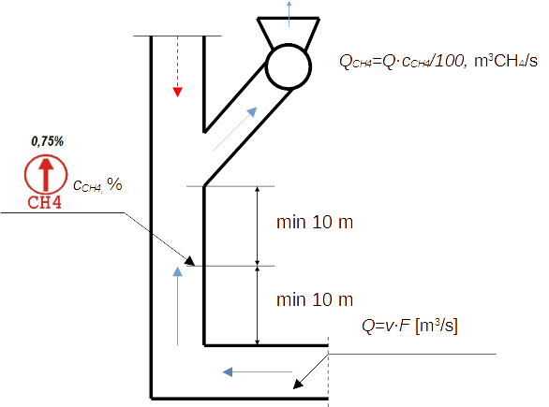
Methodology for measuring exhaust shaft's air outflow
and methane (VAM) concentration in it
Schematic diagram for measuring methane emissions from a ventilation shaft

Slide 4
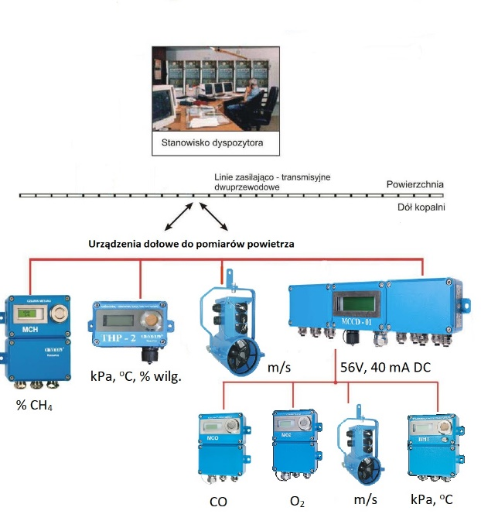
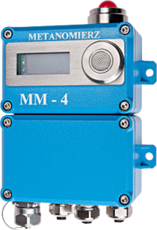




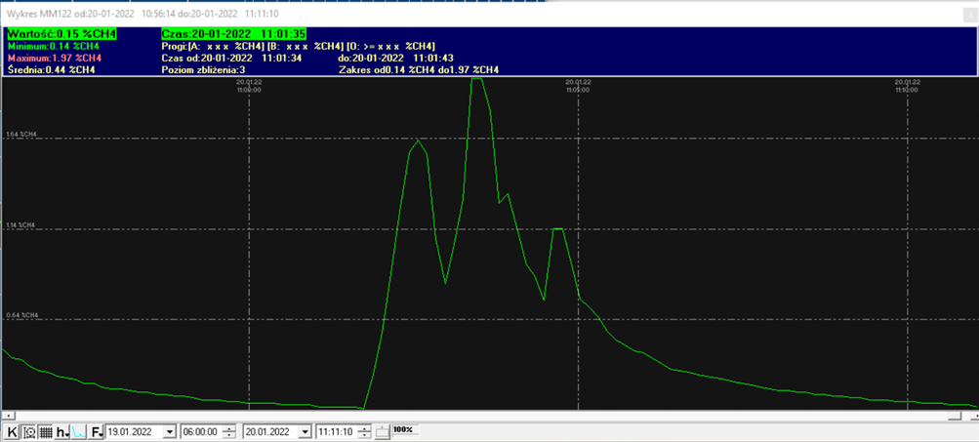
Gas and air monitoring system
Typical methanometer installed at EM „Barbara” mine and widely used in Polish mines
Underground air flow equipment

Slide 5
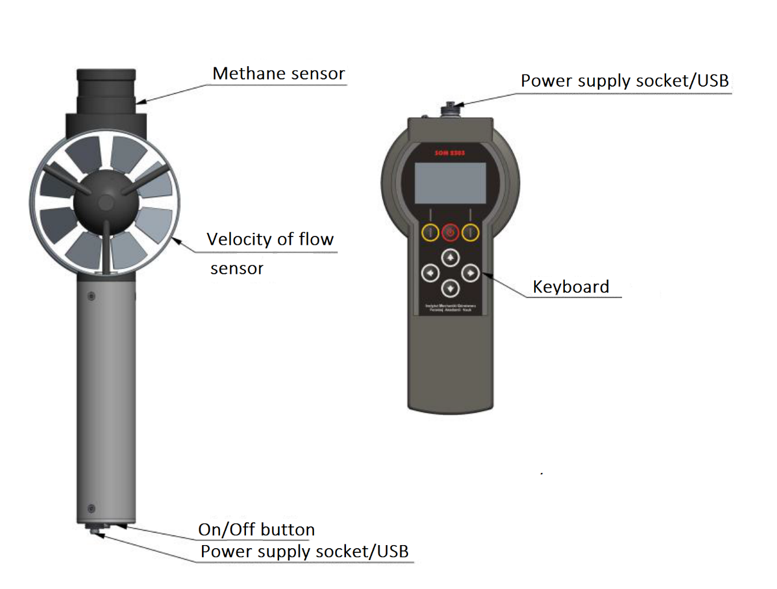
Methaneamometer SOM 2303
A combined meter of velocity and methane
Methane concentration sensor:
Range of methane concentration: 0 ÷ 100% V/V**
Sub-Ranges : 0 ÷100% LEL***; 5 ÷100% V/V**
Methane concentration measurement error::
0,1% for range 0 ÷ 2% V/V**
5% for range 2 ÷ 5% V/V**
3% for range 5 ÷ 60% V/V**
5% for range 60 ÷100% V/V**
Low concentration sensor type: catalytic
High concentration sensor type: conductometric
Response time T90: < 3 s
Resolution of measurement: 0,1%
for range 0 ÷ 100% V/V**
Abbreviations: * rdg – reading, ** V/V – volume fraction in percent
(volume/volume) *** LEL- Lower Explosive Limit.
1.3 Measurement frequency: 1 Hz
1.4 Wireless connection: Radio module 868 MHz, SRD, 14 dBm
1.5 Cable connection: USB 2
1.6 Power supply: Ni-MH 4,8 V/ 1,5 Ah rechargeable battery
1.7 Duration of continuous operation: 10 h
1.8 Operational temperature range: -20oC < Ta < 40oC
1.9 Operational relative humidity : < 95% rH (no condensation)
1.10 Ingress protection: IP 54
1.11 Dimensions of Bi-sensor unit: 313 x 40 / 102 x 60 mm
1.12 Carrying case dimensions: 330 x 110 x 90 mm
1.13 Bi-sensor unit mass: 0,75 kg
1.14 Mass with carrying case: 1,51 kg
1.15 Additional functions:
Real time clock.
Calibration of the methane sensor via a computer.
Autonomous operation mode (standalone recorder).
1.16 Memory of measured data:
74 measurement sessions, exclusively in the autonomous mode.
Session duration limit: 138 hours.
Cyclic buffer overwriting the oldest data.
Automatic session numbering (incremental).
1.17 Intrinsic safety category: I M1 Ex ia I Ma
1.18 Mechanical damage prevention: Protect from shocks and vibrations
1.19 Dust concentration limit: 1000 mg/m3
Velocity sensor:
Range of velocity: ± (0,16 ÷ 10,0 m/s)
Velocity measurement error: ± (0,5% rdg* + 0,02 m/s)
Resolution for velocity measurement : 0,01 m/s
Sensor type: rotating vane

Slide 6
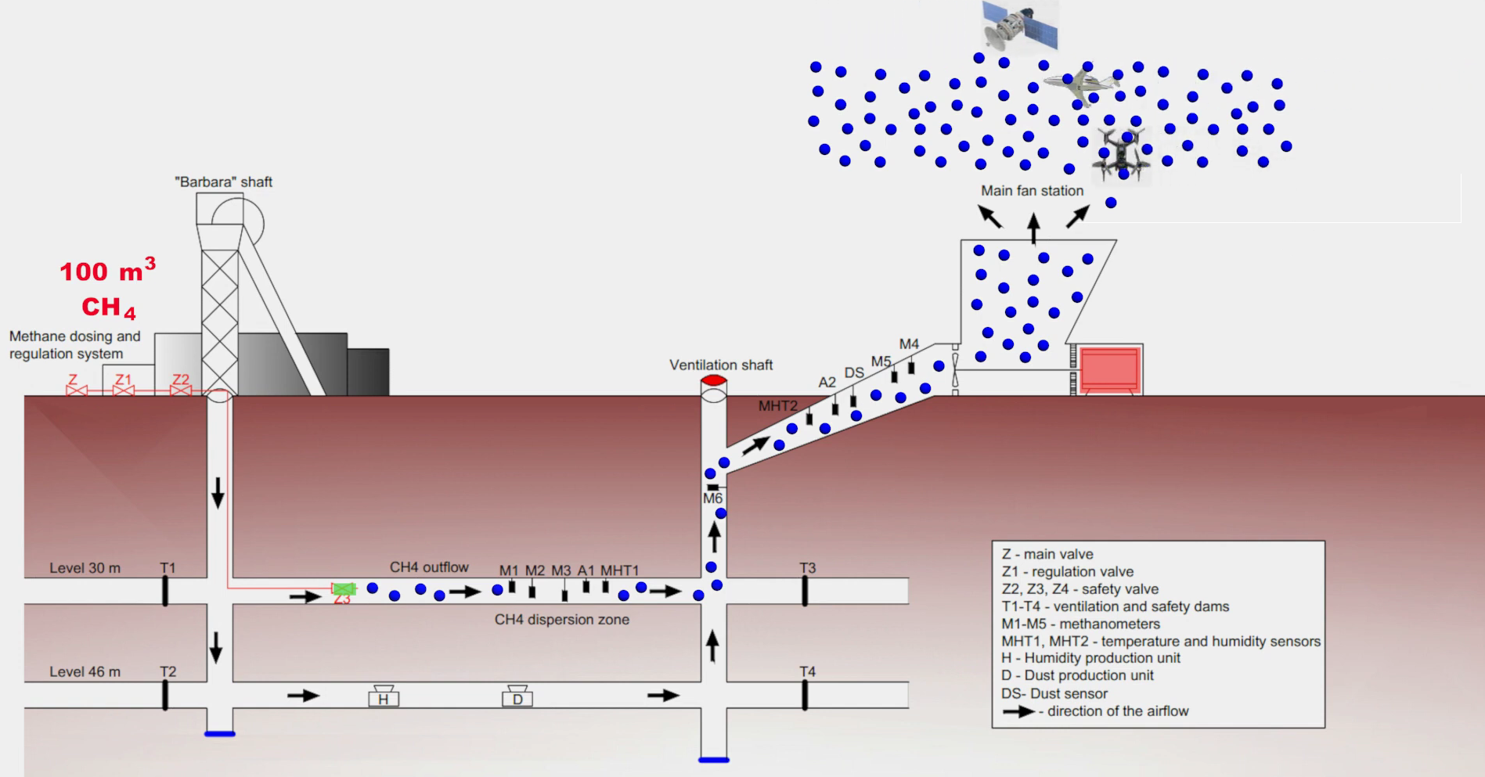
Video

Slide 7
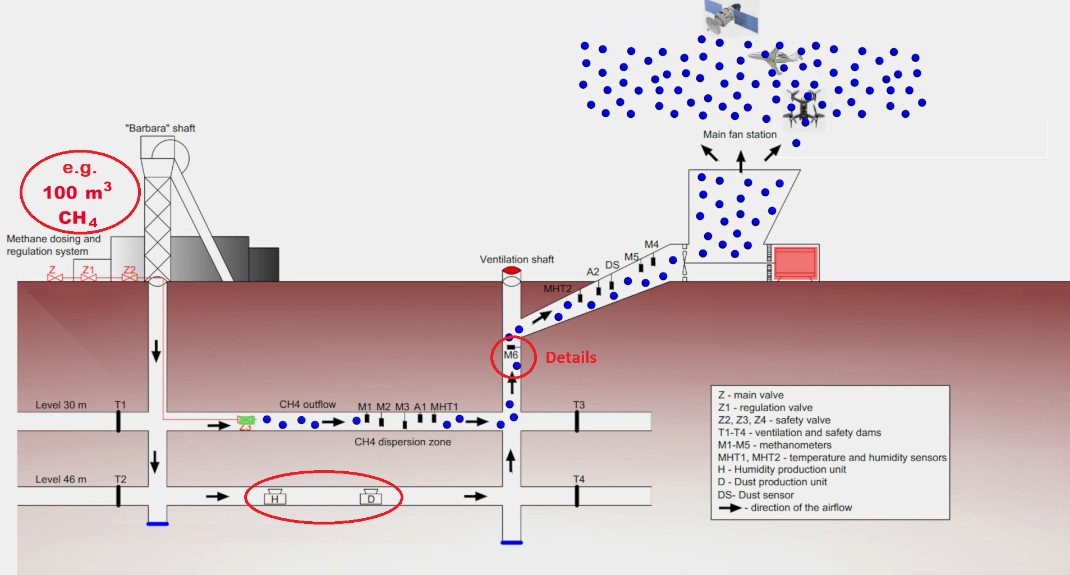
the same amount of methane

Slide 8
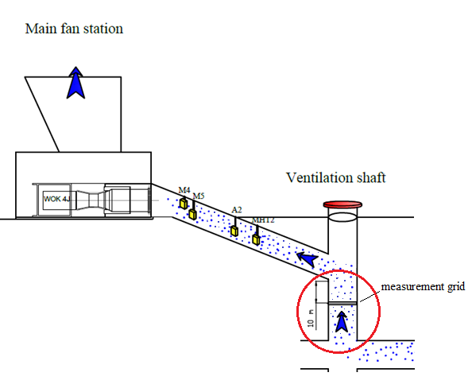
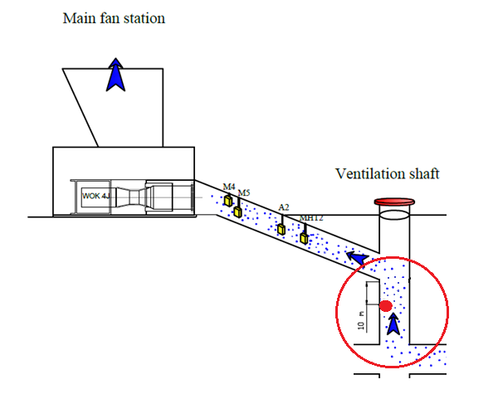
VAM emissions measurement system in ventilation shafts
Current methane measurement system
Proposed methane measurement
system for the research

Slide 9
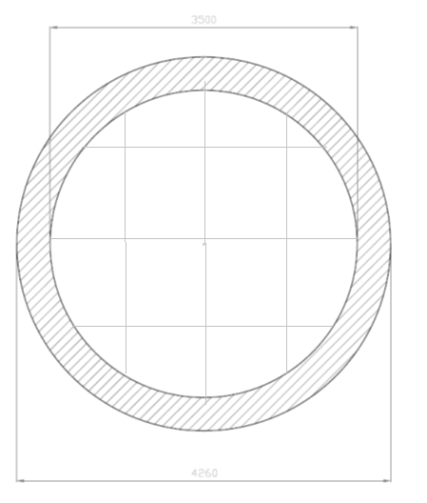
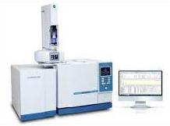
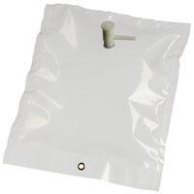
cross-section of the ventilation shaft
gas sampling bag
chromatograph
methane sensor
Current methane
measurement system
Proposed methane
measurement system
for the research
gas sampling hosepipes
(are the measurements
correct?)

Slide 10
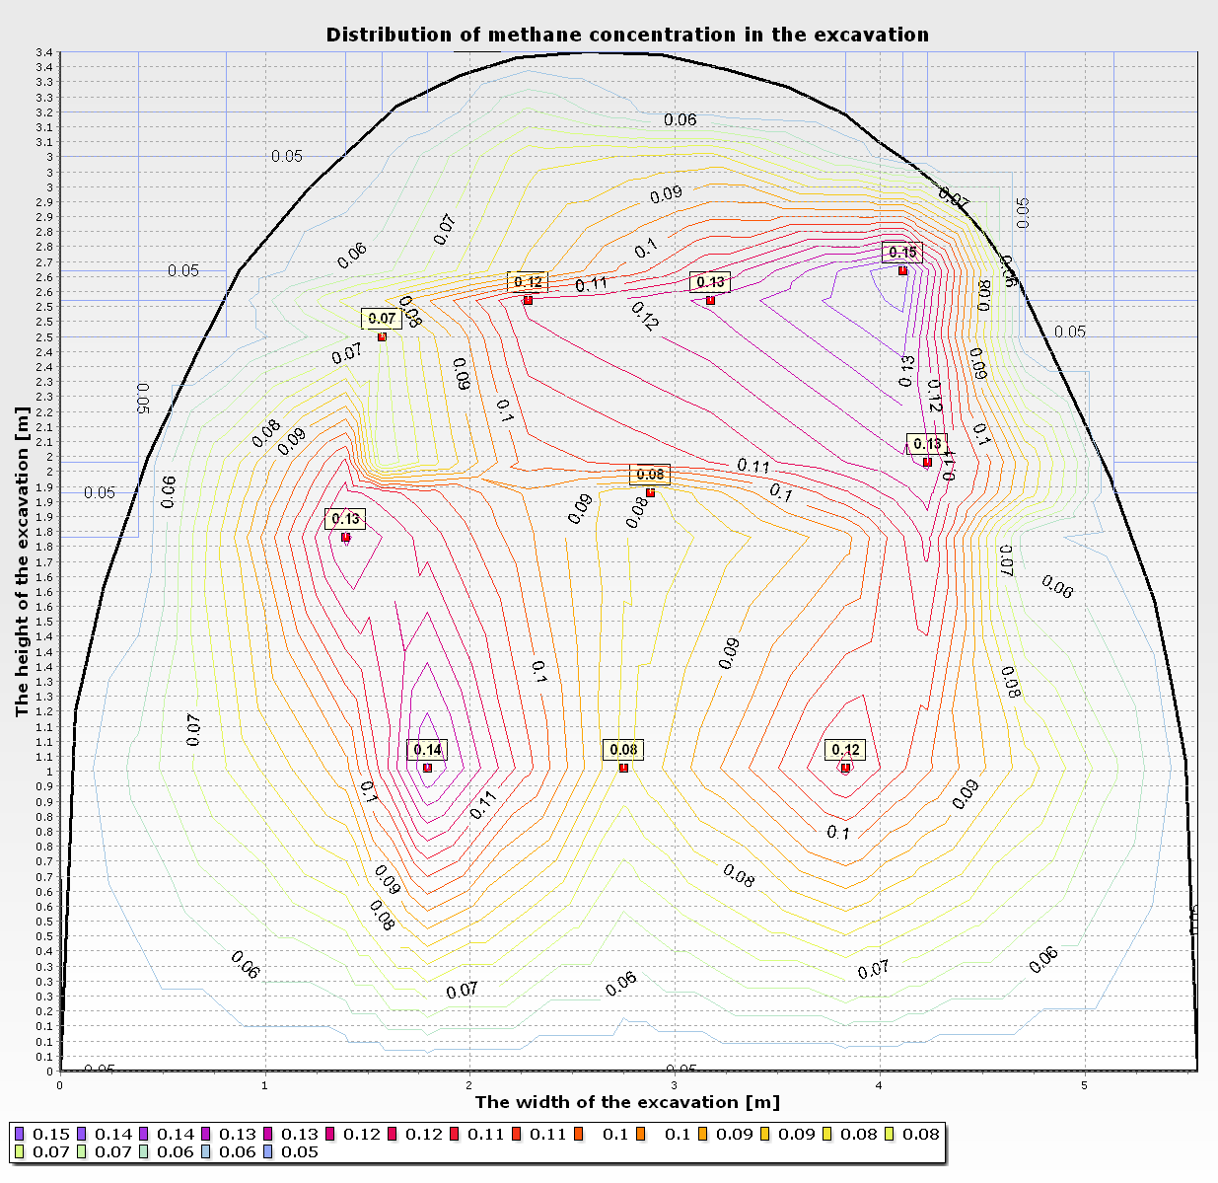

Slide 13
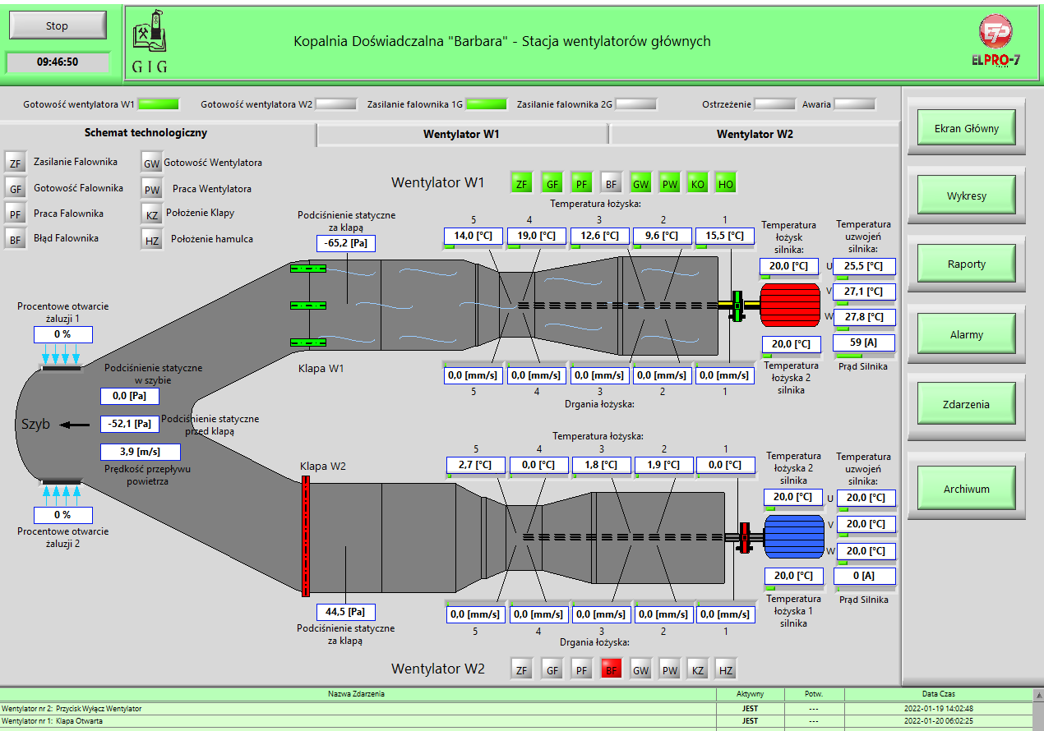

Slide 14
Possibilities of research at em „Barbara”
The underground and surface infrastructure of EM "Barbara" allows the establishment of in-situ conditions identical to those in operating mines and therefore enables:
Verification of methane measurements in mine ventilation shafts | Assessment of methane emission measurements precision
It can be achieved by: comparing the readings of the sensors currently used in the shaft (1 sensor on the sidewall opposed to averaged value from the grid) installing a measuring grid with several methane and air velocity sensors and later confirming the readings of these sensors by chromatography based on the indication of the grid measurements results, a comparison of the calculated value of a total amount of methane released from the ventilation shaft with the total amount of methane input | It can be achieved by: emitting a specific quantity of methane over a specified time interval (e.g. 1 tonne of CH₄ in 24h) to verify the accuracy of indications from 3 types of measuring devices (satellite, plane, drone), the possibility of obtaining a certain concentration of methane 0 – 2% (even 4%), adjustable airflow (0 – 4000m³/min), possibility to simulate dust conditions, possibility to simulate humidity conditions, Potential advantages of the planned research: certainty of the emitted methane amount, possibility to study the influence of seasons and weather conditions (wind, fog) the possibility of developing an accurate measurement system (e.g. laser methane sensors at the outlet of the diffusers)

Slide 15

THANK YOU FOR ATTENTION
Jacek Skiba Ph.D.Eng,MBA
Robert Hildebrandt Ph.D.Eng
Central Mining Institute-National Research Institute
Department of Mining Aerology
Plac Gwarków 1
40-166 Katowice
Poland
t: +48 32 259 23 00
m: +48 512 293 839
jskiba@gig.eu
www.gig.eu

