Slide 1
Enabling Favorable Policy Conditions for Methane Mitigation Projects in the Context of Central Asia
Third Almaty Energy Forum
November 7, 2023
Volha Roshchanka
U.S. Environmental Protection Agency
Co-chair, Global Methane Initiative Coal Mines Subcommittee

Slide 2
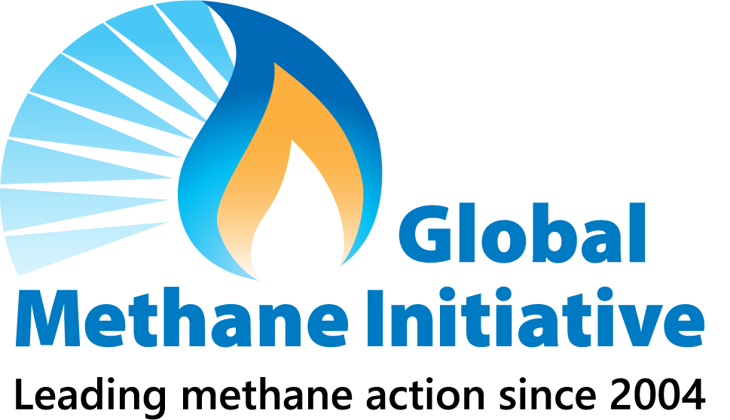

GMI and Technical Engagement in Kazakhstan
8th International Forum for Energy in Sustainable Development
UNECE Workshop Best Practices Guidance: Kazakhstan
Coal Mine Assessments
O&G: Methane Measurement Study at KMG facilities
Analysis of Policies Affecting CMM Projects
Kazakhstan Joined GMI
Pre-Feasibility Study - WWTP
2008
2009
2011
2013
2014
2015
2016
2017
2018
2019
2021
Landfill Assessments
Pre-feasibility Study for Arcelor Mittal Mines
CMM Policy Roundtable
Workshop on CMM and its Role in Transition
Wastewater Biogas Workshop
O&G: Study on utilization of associated petroleum gas
GMI-sponsored sessions on CMM mitigation at the World Mining Congress in Astana
GMI’s deepest engagement in Central Asia is with Kazakhstan.

Slide 3
Mitigating Methane
Positive Outcomes
of Capturing
and Using Methane
Better air and water quality
Improved human health
Increased worker safety
Enhanced energy security
Economic growth
Methane is a marketable commodity and a potent greenhouse gas
Mitigating methane has many benefits. It is an opportunity to avoid waste while capturing and converting methane to useful energy
Successful, commercially available mitigation technologies and practices exist across multiple sectors
Yet, a number of barriers hinder methane abatement
Policies can help address some of these barriers
Notes:
Because methane has a relatively short atmospheric lifetime (~12 years on average, compared to hundreds of years or more for carbon dioxide) methane concentrations respond relatively quickly to reduction efforts.
Methane is a potent greenhouse gas: 28 to 36 times more powerful than carbon dioxide when measured over a 100 year time scale.
Since the industrial revolution, methane has contributed more than one-third of the warming we have observed today.
By reducing emissions of methane now, we can rapidly bend the global warming curve in the coming decades.
Human activities cause about 60% of global methane emissions.
Methane reductions have been successfully demonstrated in oil & gas, coal mining, municipal solid waste landfills, agriculture/manure management, and wastewater sectors across the globe, with economic, air quality, health, and safety benefits.

Slide 4

Policy Landscape and Methane Mitigation
Policy defines the playing field, creating the tipping point for feasibility of methane mitigation projects
  In several countries (Australia, Germany, Poland, UK, China, United States), introduction of policies supporting coal mine methane (CMM) led to more implemented projects
Policy, legislative and regulatory environment can create incentives for companies to abate methane emissions
Providing targeted policy support can, in some cases, facilitate feasibility of projects, even if initial geophysical or market conditions are less than optimal

Slide 5
Policies and Regulations Impact Feasibility of Methane Mitigation Projects
Many policies and interactions among policies create a regulatory environment that impacts project feasibility: Too many to list!
Taxation policy (royalties, fees)
Methane reporting requirements for companies
Safety standards and their implementation
Gas ownership rights
Green financing instruments
Support for R&D
Customs and import fees on technologies
Emissions or technology standards
Economy-wide fiscal and other policies
Permitting and licensing processes
Voluntary programs

Slide 6
What Major Policy Conditions Universally Impact Cost-Effectiveness of Methane Mitigation Projects?
Price on local energy: cost-reflective vs. subsidized
  Financial feasibility of mitigation projects depends on price they can get for natural gas, heat or electricity. If methane avoided through mitigation projects has to compete with low-cost/subsidized energy, such mitigation projects might not be financially feasible.
Price on carbon/pollution (tax or cap-and-trade)
  If a company can prove that its project/investment achieves emission reductions and such reductions have market value, it can boost financial feasibility of projects and help such projects compete with other investments proprieties within a company.
Access to energy markets
  Can a coal mining company physically and legally sell methane or electricity to a grid or natural gas pipeline infrastructure? Can an oil and gas company route associated petroleum gas to a market?

Slide 7

Options to Improve Cost-Effectiveness of Methane Mitigation Projects
A longer-term option to improve cost-effectiveness of methane mitigation projects might be through reducing/removing subsidies for fossil fuel energy (very complex!)
Short-term options to improve cost-effectiveness of methane mitigation projects:
Include methane mitigation projects in feed-in tariffs and obligations
Include methane in carbon pricing mechanisms
Ensure access to energy markets
Direct technology subsidies, grants, financing

Slide 8

Feed-in Tariffs and Obligations
Avoiding methane waste has many benefits; such benefit could be reflected in pricing and sourcing policies for energy generated from avoided emissions
Many countries have policies that require paying premium price on renewable energy (feed-in tariff) or, alternatively, have obligations for utilities to purchase a share of their energy from renewable sources, such United States, Egypt, EU countries, Kazakhstan
Methane recovery and use in coal mines or oil fields (associated petroleum gas) are often not cost-effective, esp. when competing with subsidized energy prices
Can feed-in tariffs and obligations be extended to methane mitigation projects?

Slide 9
Carbon Pricing Mechanisms
In coal mines, Ventilation Air Methane (VAM) accounts for 60-80% of methane emissions but is low concentration and can only be destroyed, presenting energy value in limited cases. Such projects can derive value from carbon pricing.
  Pollution tax or cap-and-trade exist in many countries, such as EU, United States (California), Canada (Quebec), Kazakhstan
Mechanisms under the Kyoto protocol helped many projects emerge. New mechanisms under Article 6?
Either carbon tax or cap-and-trade require rigorous monitoring, reporting, verification (MRV) systems to estimate baseline emissions (national-level MRV) and confirm emission reductions (project-level MRV)
  UNFCCC and other carbon trading system methodologies exist for certifying emission reductions from flaring reduction and associated gas projects
  National/subnational governments need to establish and recognize MRV rules/ methodologies/protocols that allow companies calculate and certify project reductions

Slide 10
Access to Energy Markets
Energy recovered through methane mitigation can be used on-site, such as to meet heating/electricity needs of operators at coal mine or oil and gas facilities
Mitigation projects can generate more energy than a facility can use. Access to off-site energy markets can be key to incentivizing mitigation
Can avoided methane be physically and legally sold to natural gas pipelines? Can avoided methane be used to generate electricity/heat, which can be sold to the grid or district heating/industrial systems? Does regulation allow third parties to sell power to the grid?
Emerging (but expensive) technologies that do not require infrastructure: Microturbine, mini gas-to liquids (GTL), mobile Compressed Natural Gas (CNG) technologies. Might require institutional and financial support.

Slide 11

Direct Technology Subsidies, Grants, and Financing
When achieving methane reductions through regulation is not easy, countries have turned to providing subsidies, grants, financing for companies (often in combination with regulatory approaches) to adopt greener technologies
  The government of Canada set up a fund of $750 million CAD to provide financial support for oil and gas companies to adopt greener technologies and to maintain jobs in the sector
  The United States is in the process of developing a program and regulation to provide grants to oil and gas companies to improve measurements of methane emissions, while developing regulations for charging companies a fee for waste emissions
International financing for the fossil sector projects is scant; Kazakhstan has domestic financing schemes to build upon. Gap in financing energy transition

Slide 12
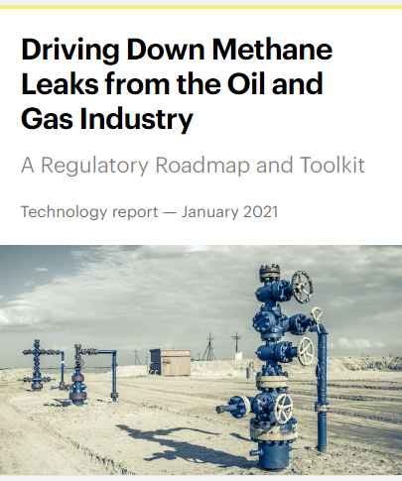
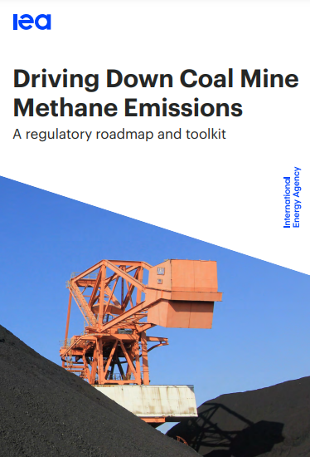
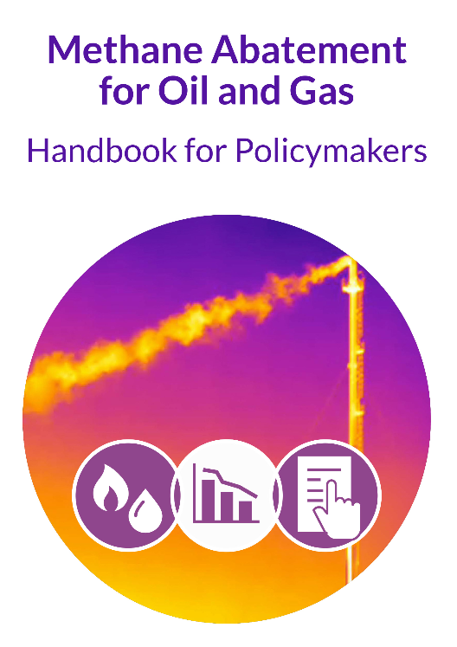
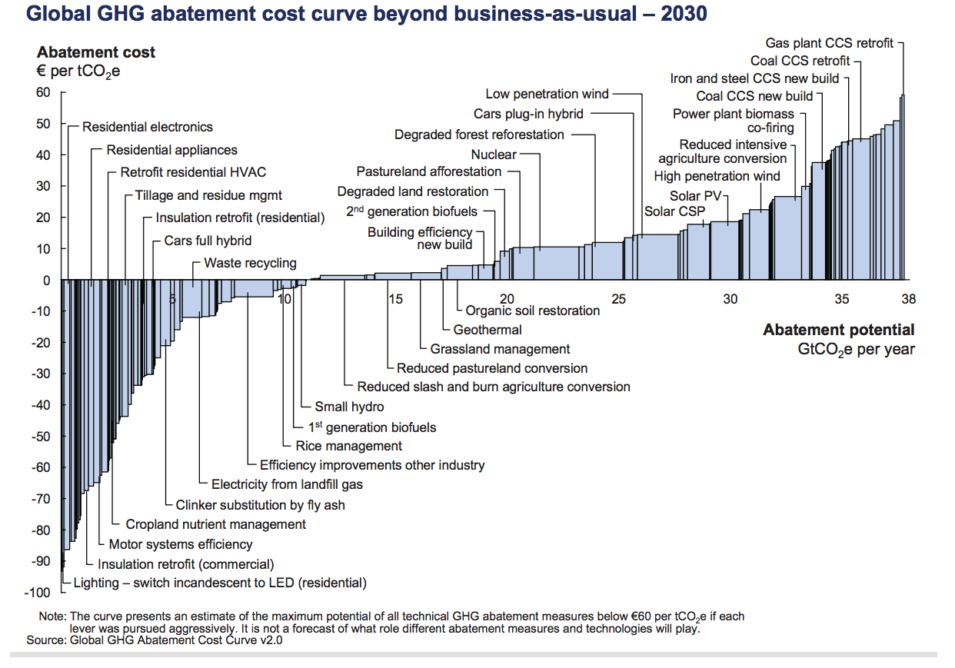
Identifying Suitable Policies
Policies also create enabling conditions for financing. Resources are available on methane policy in the fossil sectors
Tools can help choose the most suitable policy instruments:
  Cost-benefit analysis
  Cost-effectiveness analysis: marginal abatement cost curve
  Policy modeling studies
Which policies does a country have that are effective? (E.g., taxation, feed-in tariff) Is there an option to lean into an effective policy?

Slide 13
Conclusions
Many policies and their interaction affect feasibility of methane mitigation projects. Three major policies dictate cost-effectives of mitigation projects:
  Price on energy; carbon pricing mechanism; access to energy markets
To make the impact of such policies positive on mitigation projects, policymakers can:
  Include methane mitigation projects in feed-in tariffs and obligations
  Include methane in carbon pricing mechanisms
  Ensure access to energy markets
Direct technology subsidies, grants have been used to accelerate deployment of greener technologies, sometimes in combination with regulatory requirements
Need for financing mechanisms for fossil-based mitigation projects. Enabling policy conditions can also help arrive at financing faster

Slide 14
Thank you!
Volha Roshchanka
Co-Chair
GMI Coal Mines Subcommittee
roshchanka.volha@epa.gov

